Slide 1

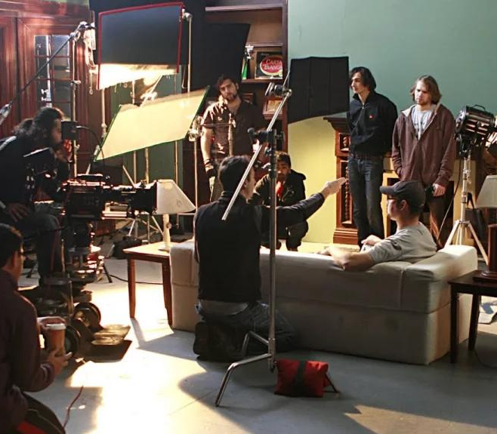
IMDB MOVIES ANALYSIS
Presented By, Pranav Jadhav
Loom Vedio Link
excel link

Slide 2

TABLE OF CONTENT
Project Description
Tech Stack used
Approach
Analysis
Insights

Slide 3

PROJECT DESCRIPTIONS
Analyzing the IMDB movie dataset to find the trends and insights which could be helpful for the Directors and Investors in the Film Industry.
The dataset consists of the details about the movies, the genres, actors, their likelihood, and many more,
Using statistical knowledge and excel formulas to find the conclusion

Slide 4






TECH STACK USED
Microsoft Excel 2016

Slide 5
APPROACH
For this project I have used Microsoft Excel 2016,
The approach to this project involves using Excel to clean, manipulate and analyze the dataset. Various formulas were applied to perform data cleaning, create new columns, alter data based on specific criteria, group data, and generate visualizations. By analizing excel tables, the project can effeciently handle large datasets and extract relevant information from the given data.

Slide 6

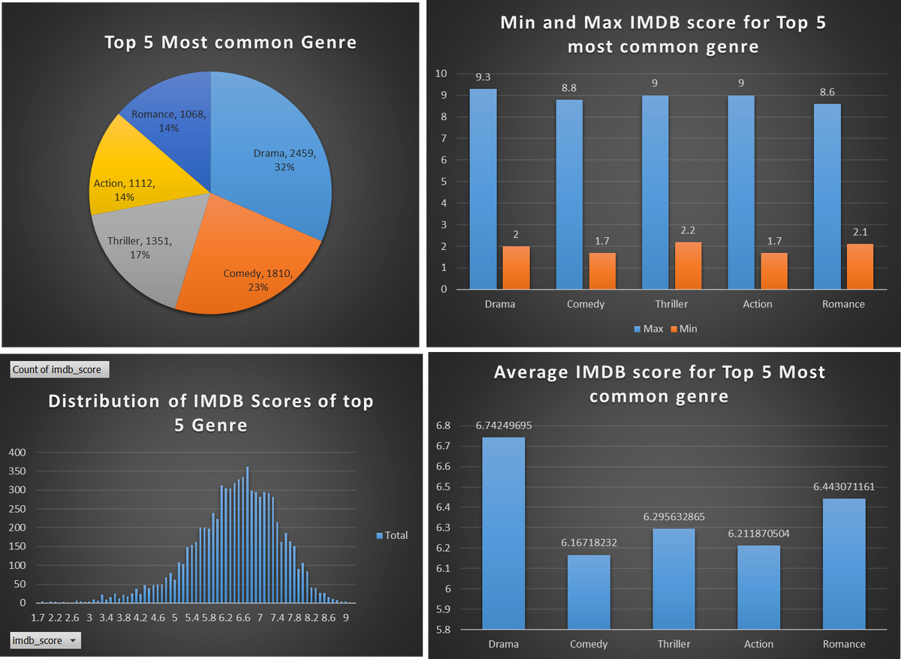
GENRE ANALYSIS
The top 5 Most Common Genre are, Drama , Comedy, Thriller, Action, Romance .
Directors have worked on these Genres more as per the IMDB Movies data, Where Minimum IMDB score they have attended is 1.7 by action and comedy while Maximum of 9.3 by Drama
Most of the movies for these genres have IMDB score of ranging from 3.4 to 8.6 with average IMDB score of 6.37 with median and mode of IMDB Score of 6.46.
Futher more analysis of variance and standard deviation we got a value of 1.16 and 1. 07 respectively which states that the movies are distributed by on an average +/-1.16 to the mean

Slide 7
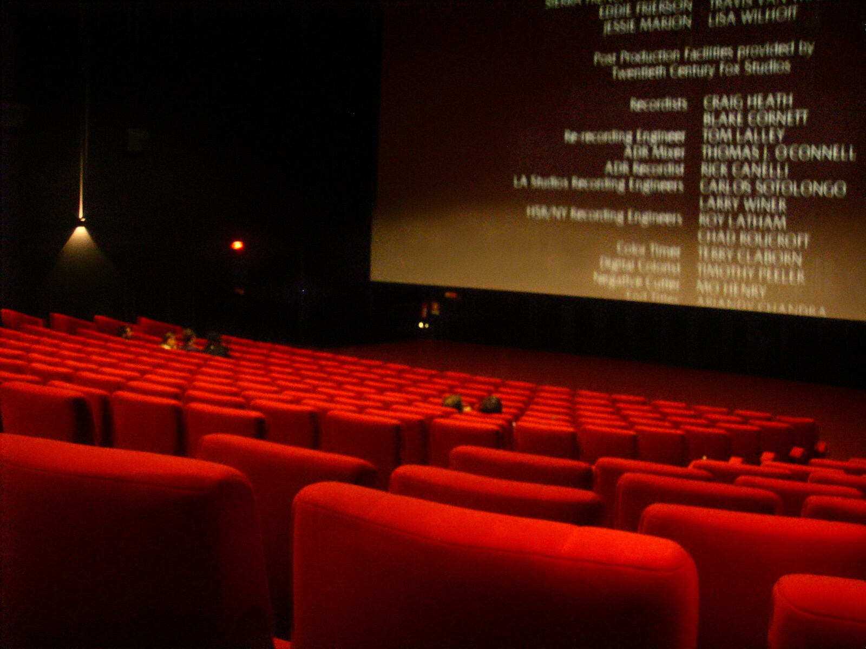
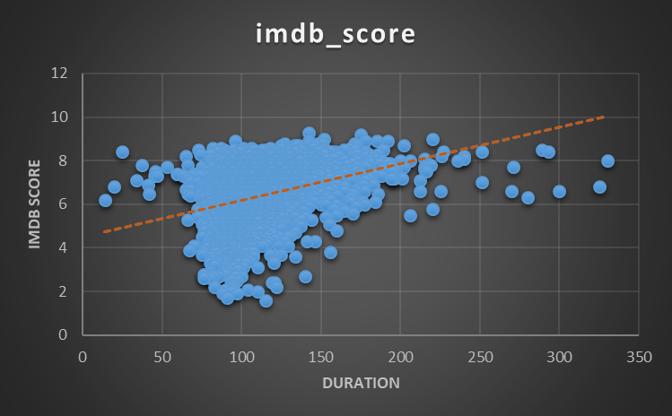
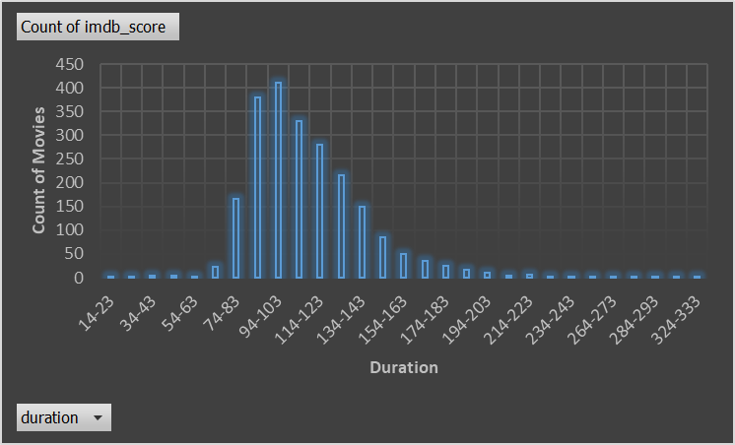
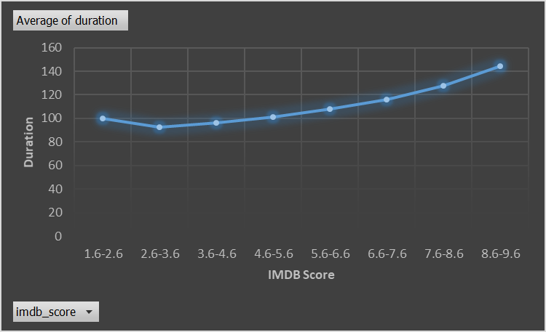
DURATION ANALYSIS
Most of the movies lies in the duration range of 74 mins to 163 mins, where the Maximum IMDB score 9.3 and Minimum is 1.6,
The Average duration of the movies was 112.46 mins where the average IMDB score was 6.38.
As the duration increases their are high chances of Movie being scored by IMDB above 6.5.
To attend the highest rating the movie should be of average of 144 mins

Slide 8

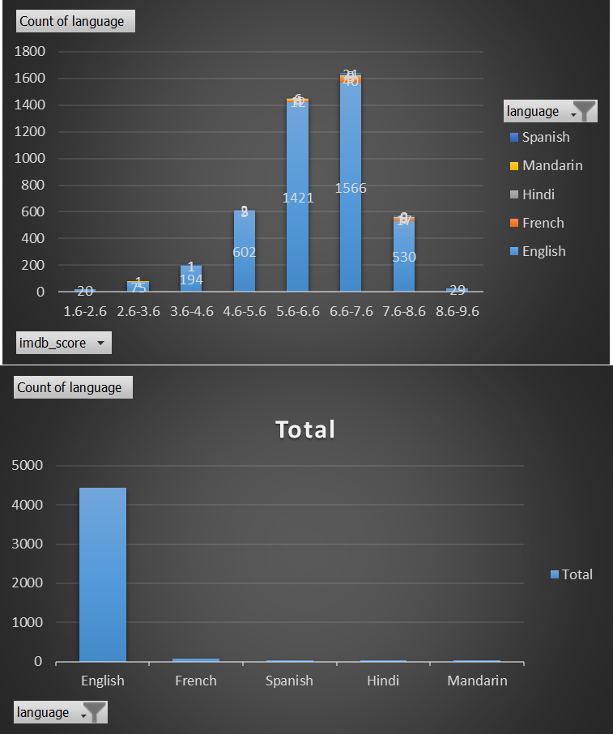
LANGUAGE ANALYSIS
English, French, Hindi, Mandarin and Spanish are the top 5 Languages choosed by the Directors and Producers to communicate with the audiance through their movies. From which English is the most used language with count of 4437 movies.
While English is the most used language and have shown Volatility in terms of IMDB score ranging from Lowest rating of 1.6 to highest rating of 9.3, on other hand other languages have shown the stable range from 3.2 to 8.5
The average IMDB score for these 5 languages is 6.38 with median of 6.5 and average distance of the other scores from the mean is 1.1

Slide 9

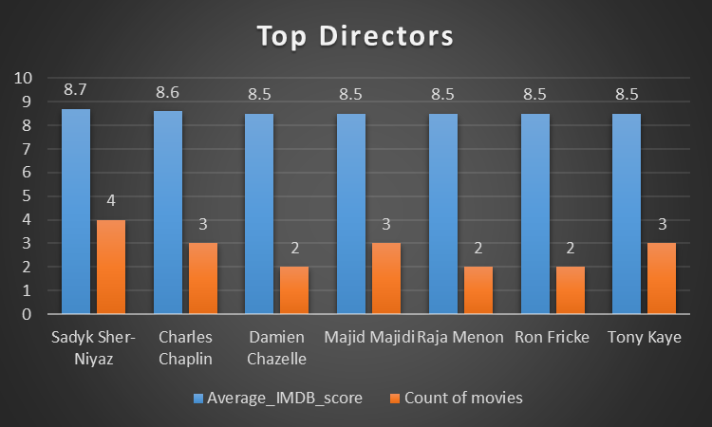
DIRECTORS ANALYSIS
Sadyk Sher-Niyaz, Charles Chaplin, Damien Chazelle, Majid Majidi, Raja Menon, Ron Fricke, Tony Kaye are the top Directors that have an Average IMDB score of 8.5 and above with atleast 2 movies in their bags.
They have performed better than 99.97 % of other Derectors in the entier dataset.
There are more directors in the list who have performed better than 90 % of the other directors.

Slide 10

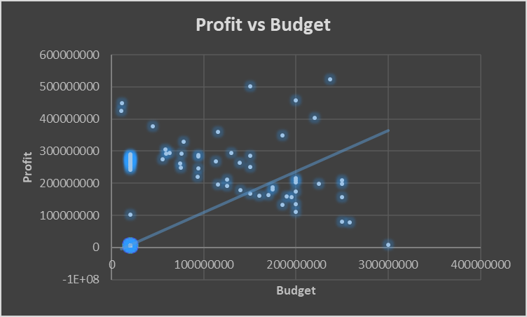
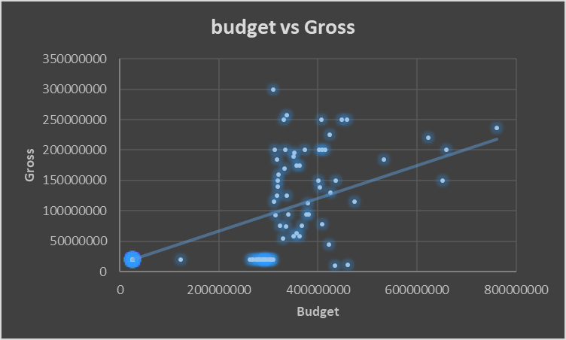
BUDGET ANALYSIS
The Budget vs Gross chart shows us that there chances of getting profit.
The coefficient of correlation also showed the value of 0.78 which indicates the positive correlation
The profit vs budget chart also shows the positive trends toward the equation of high in budget tends to high in profit.

Slide 11

INSIGHTS
In this , project I learned how to apply Excel formulas, piovt tables, power query and statitics in excel as well. It helped me in mastering my statistics and excel concepst and use it to derive the valuable insighsts which help to answer the questions and form a conclusion.

Slide 12

THANK YOU

